Slide 1
train schedule management system
© Idan sorany

Slide 2
General description
there are passengers that they have id number first and last name.
Drivers with id and seniority in years, first and last name
There are stations with name and address.
Single stop drive with source station and destination station, drive duration and cost.
A line containing the line id, frequency.
Lines data containing the data of every line and the single stop drives the line built from and the order of the stations.
Time schedualer with drive id, departure time of the drive from the first station, departure date, driver id, train id, line id, and count of available seats remain
Ticket that contain ticket number, purchase time, cost, drive id, source station, departure station, arrival time and the passanger id who purchase the ticket.

Slide 3
Requirements of the system
An easy way to fill time schedule of train company to include lines and their departure times.
Support in lines with substations.
A searching method for findind best drive from two stations by wanted departure time from departure station (no support in line change).
Ordering a ticket for wanted drive with arrival time and calculated cost of the drive.
Support availability of a train.
Manage every drive with train and driver.
Storing logs for operations in the system (3 tables).

Slide 4
Users
Manager:
Creating the lines and all their substations
Assigning driver and train to every drive
Deciding the cost and duration of every drive between two stations.
Manage the availability of the trains.
Passenger:
Searching for a wanted drive by source and destination stations and departure time.
Buy ticket for wanted drive.

Slide 5
System entities
Color Keys: Yellow – PK, Blue – FK,
Green – Both.
train: train_id, availability, num_of_seats.
Person: num_id, first_name, last_name.
Passanger: num_id.
Driver: num_id, seniority_years.
Station: station_name, address.
single_stop_drive: single_stop_drive_id, source_station, destination_station, drive_duration, cost.
Line: line_id, frequency_minutes.
lines_data: line_id, drive_sequence_order, single_stop_id.
time_schedular: drive_id, departure_time, departure_date, driver_id, train_id, line_id, avaliable_seats.
Ticket: ticket_num, purchase_time, cost, drive_id, source_station, destination_station, departure_time, arrival_time, passanger_id.
ticket_logs: id, (new/old ticket entity).
time_schedular_logs: id, (new/old time_schedular entity).
train_logs: id, (new/old train entity).

Slide 6
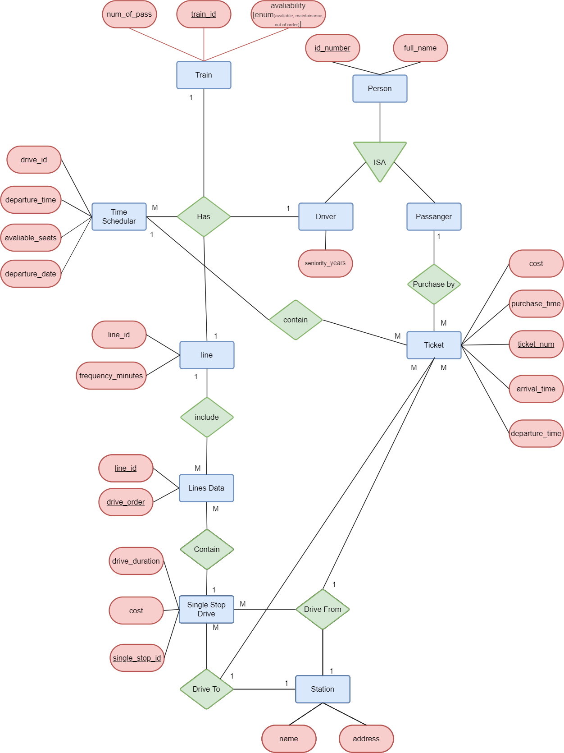
erd

Slide 7
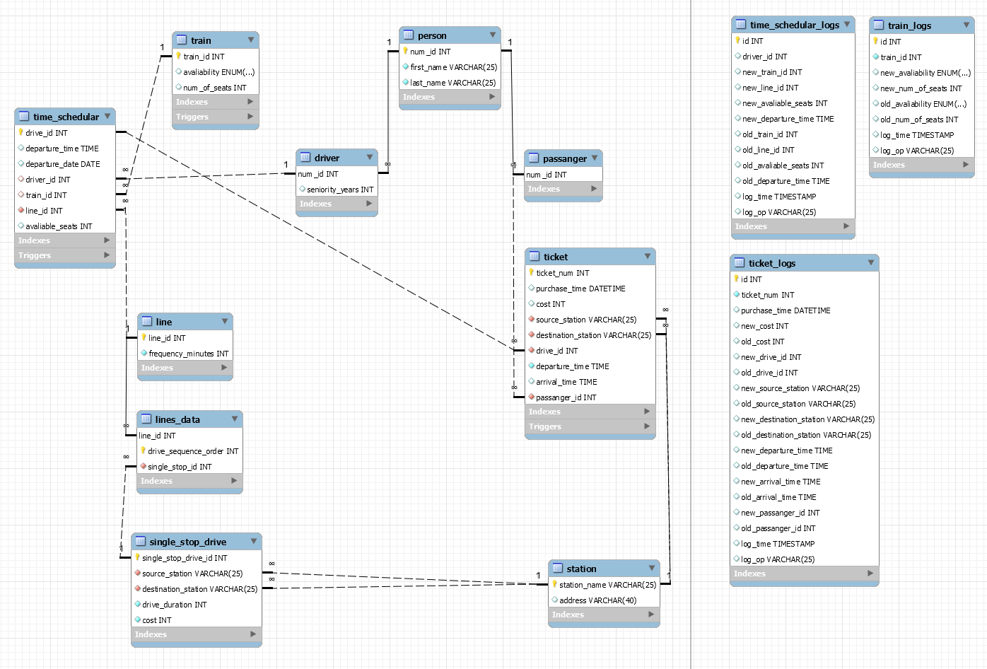
Physical erd

Slide 8
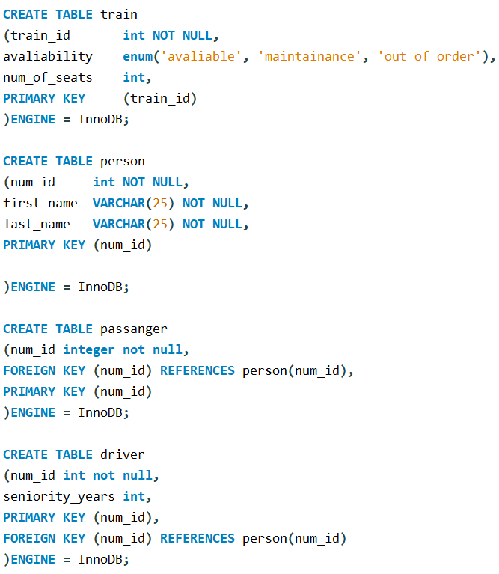
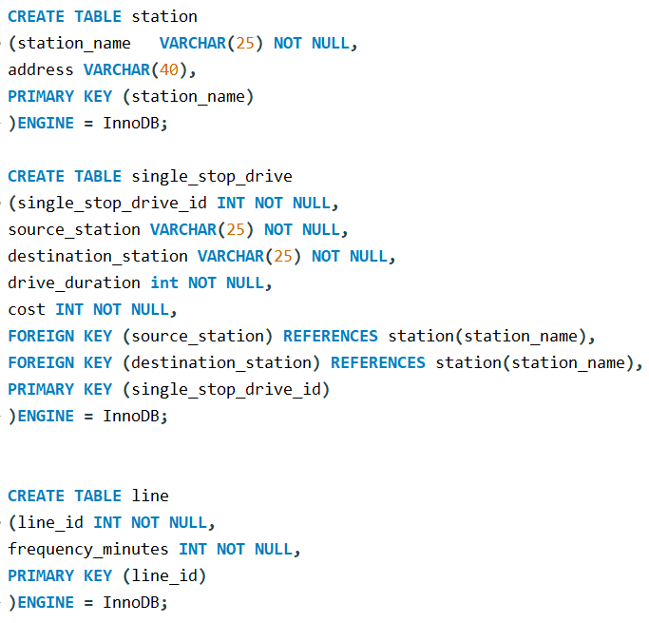
creation

Slide 9
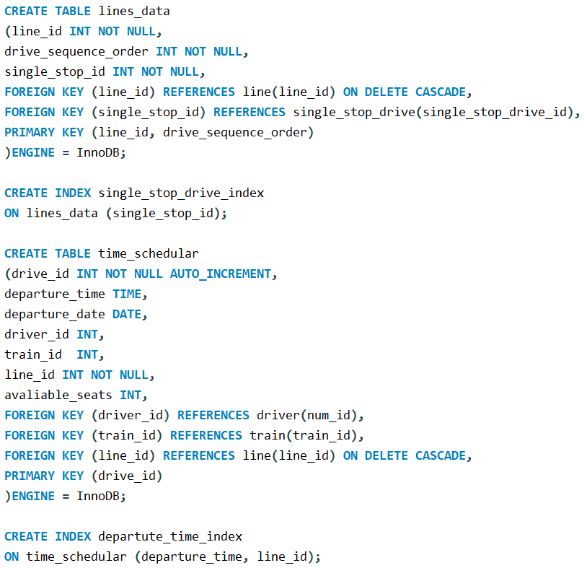
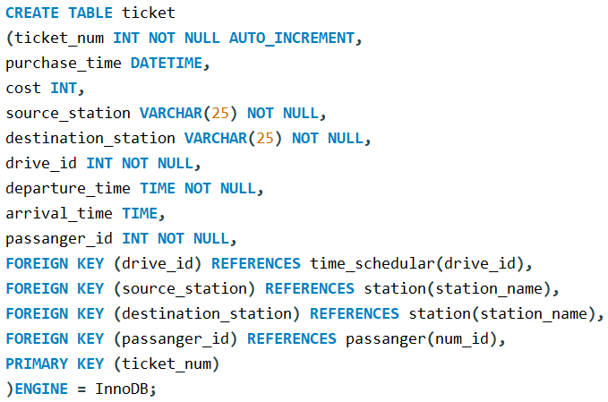
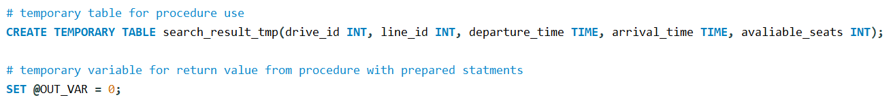
creation

Slide 10
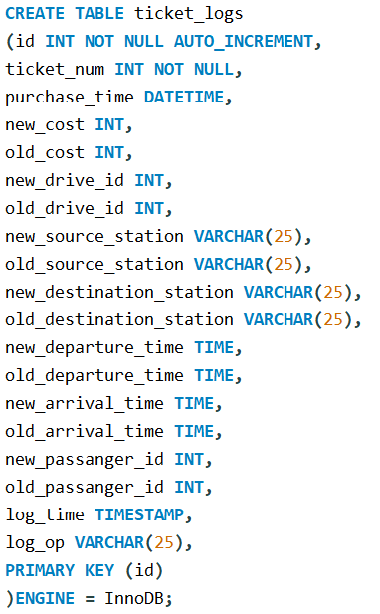
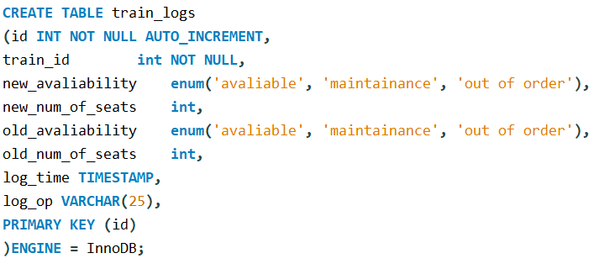
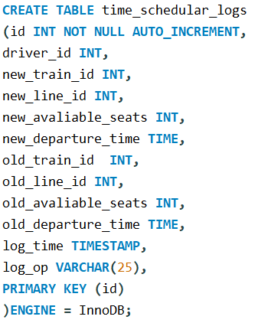
Creation (Logs)

Slide 11
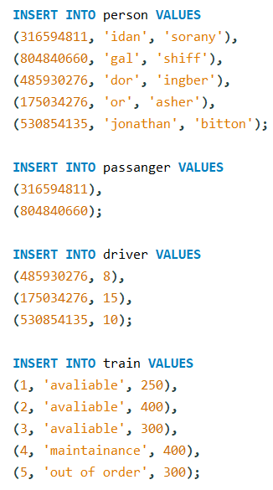
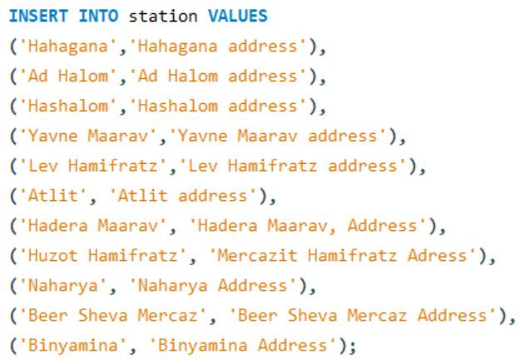
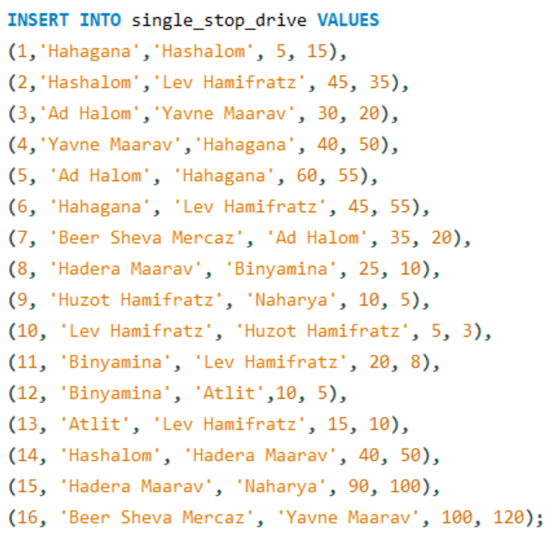
Insertion

Slide 12
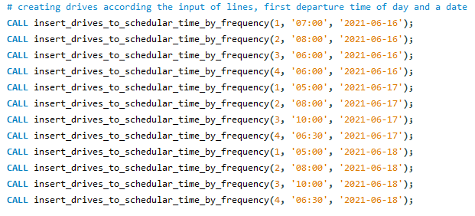
Insertion

Slide 13
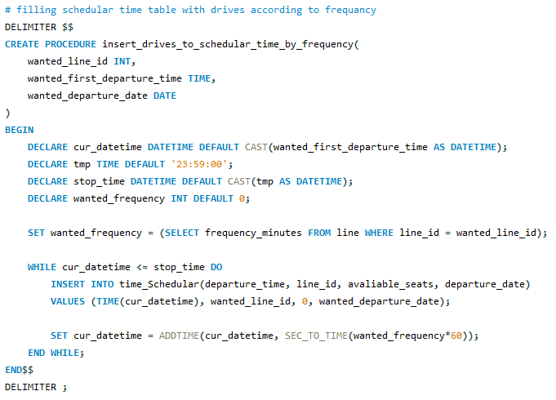
Triggers and Procedures (1)

Slide 14
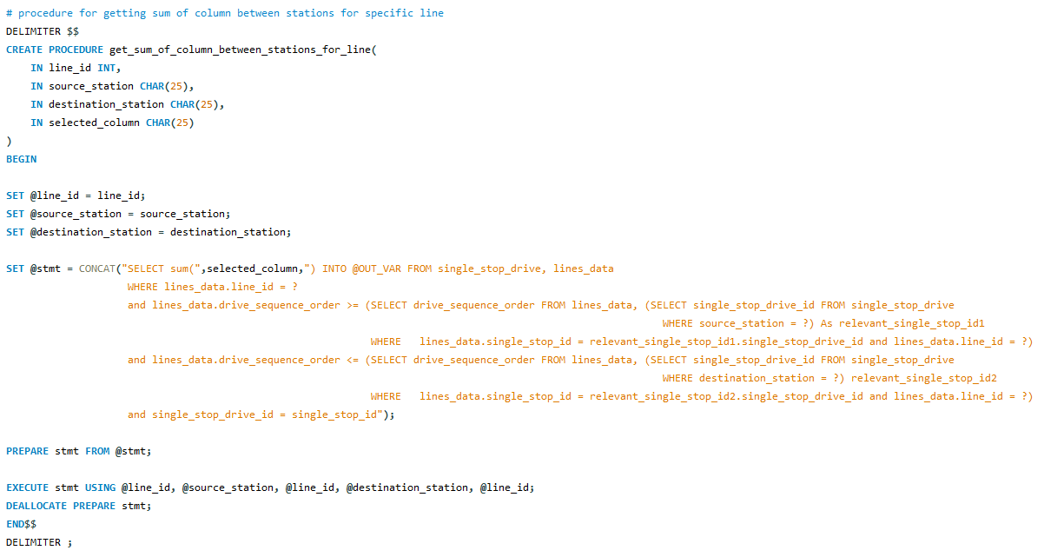
Triggers and Procedures (2)

Slide 15
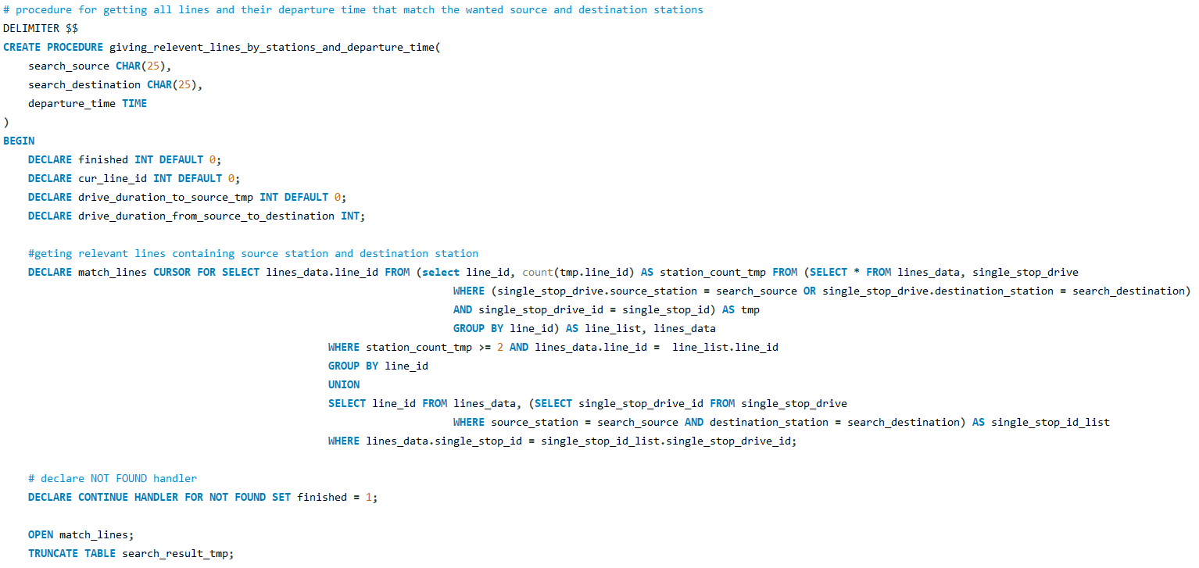
Triggers and Procedures (3)

Slide 16
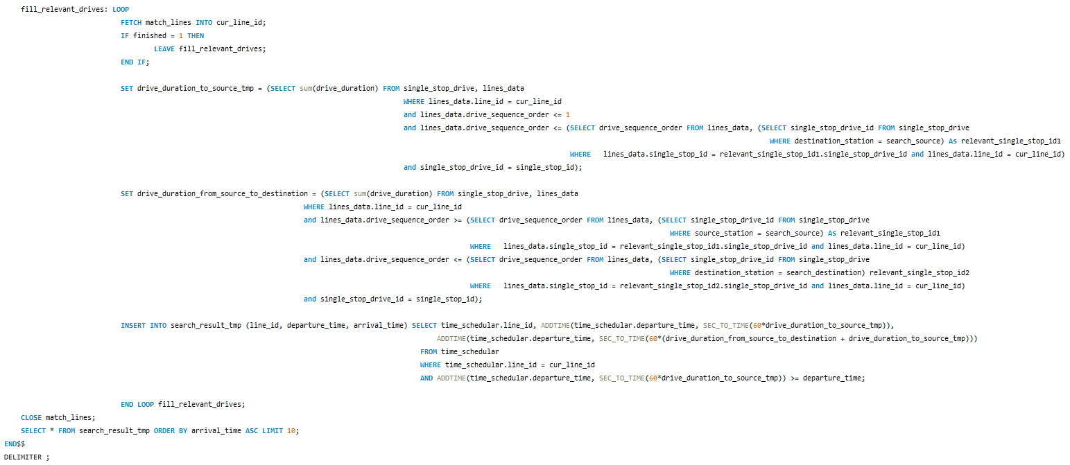
Triggers and Procedures (3 - continue)

Slide 17
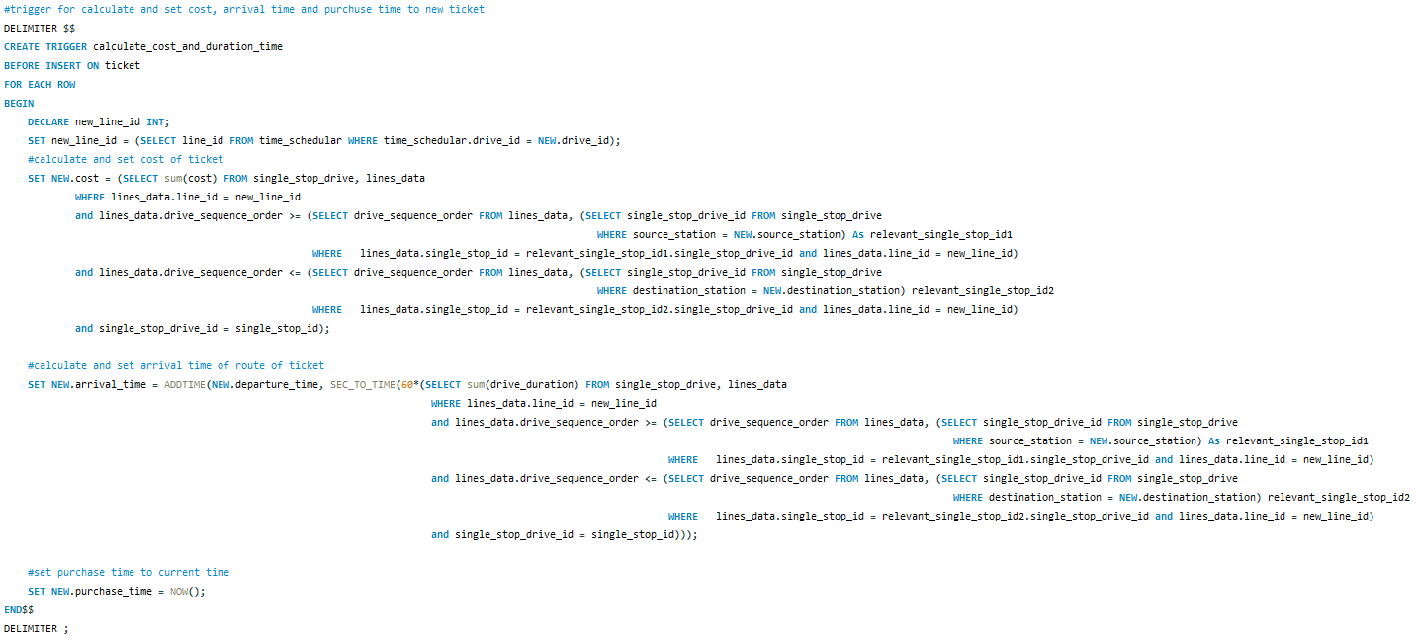
Triggers and Procedures (4)

Slide 18
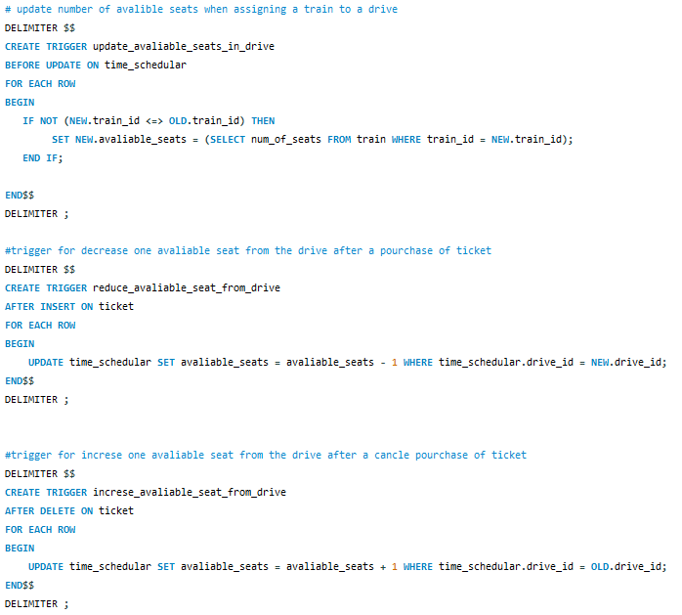
Triggers and Procedures (5)

Slide 19
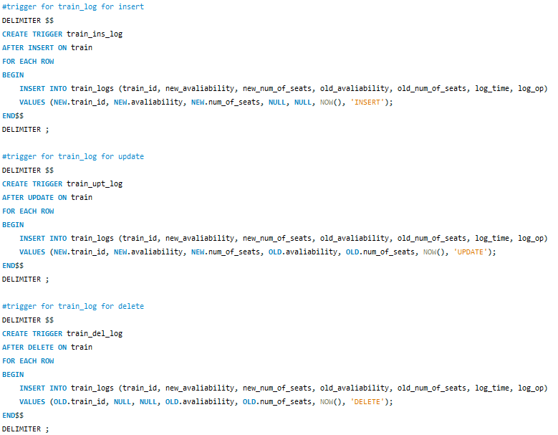
Triggers and Procedures (6)

Slide 20
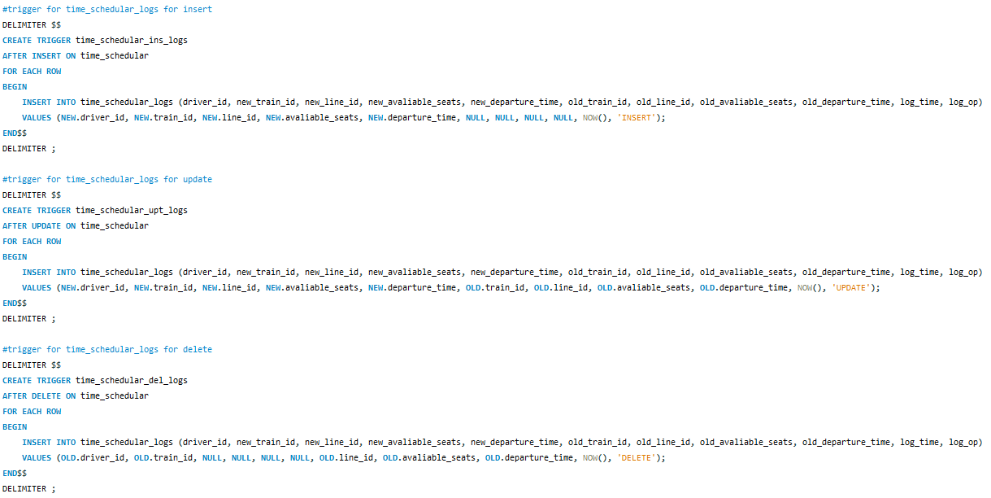
Triggers and Procedures (7)

Slide 21
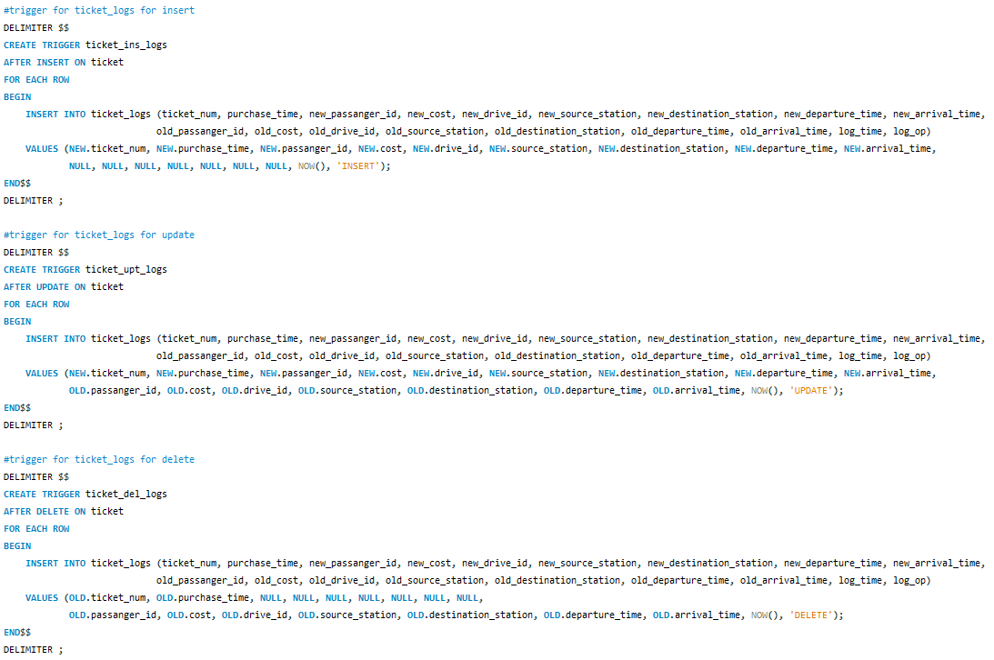
Triggers and Procedures (8)

Slide 22
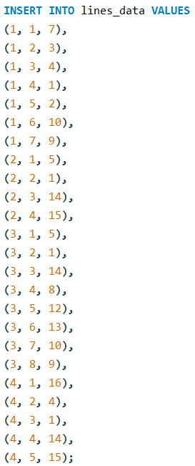
maneger queries
Creating lines out of the single_stop_drive:

Slide 23
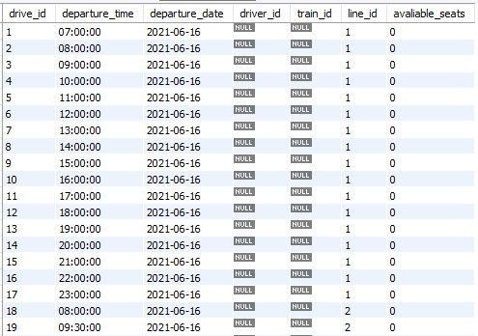
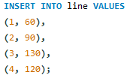
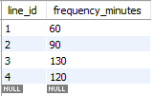
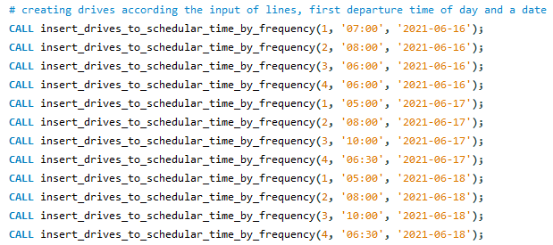
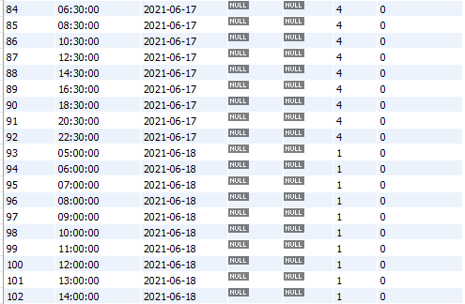
maneger queries
Insert lines and their frequency :
Calling procedure that fill time_schedular with drives:

Slide 24

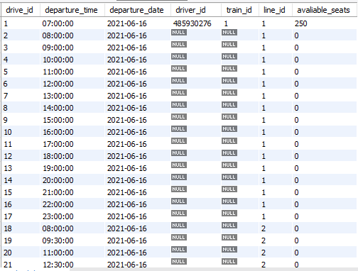
maneger queries
Assigning a driver and a train to an existing drive:
As a result of the trigger the available_seats column
updated automatically according to the train number of seats:

Slide 25

maneger queries
Get all drives that no one purchased a ticket to and a train Is assigned to:

Slide 26
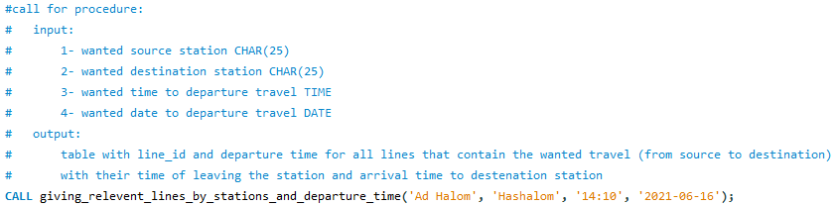
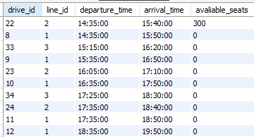
passenger queries
Searching available drives:

Slide 27

passenger queries
Purchase ticket:
As a result of the trigger cost, arrival time and purchase_time calculated automatically:
And one seat reduced from available seats of the drive (no support in separate the seats by subdrives):

Slide 28

passenger queries
Cancel ticket:
And one seat increased from available seats of the drive:

Slide 29
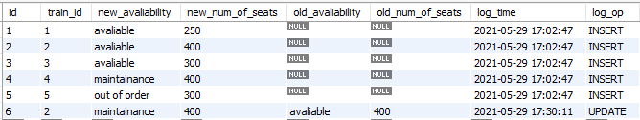
LOGS
Train table logs:

Slide 30
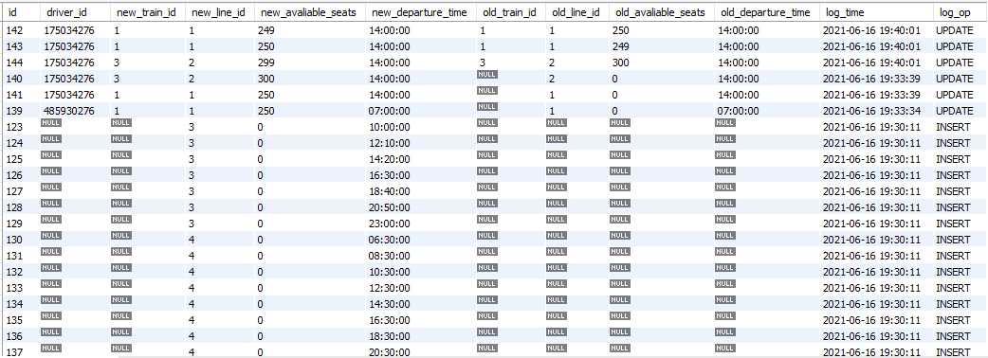
LOGS
time_schedular table logs:

Slide 31

LOGS
ticket table logs:

